Slide 1
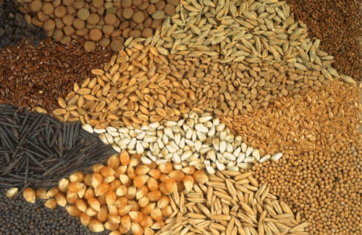
Achievements during COVID-19 lockdown

Slide 2
Ministry of Agriculture & Farmers Welfare
AGRICULTURE & ALLIED SERVICES EXEMPTED OR RELAXED DURING LOCKDOWN
Farming operations in field; harvesting & sowing; agencies engaged in procurement of agri products; tea, coffee & rubber plantations allowed with maximum of 50% workers
Farming machinery shops, Custom Hiring Centres, services related to fertilizers & seeds; fishing operations like processing & sale; hatcheries; commercial aquaria; APMC Mandis, direct marketing opns are also exempted from lockdown.
Overcoming lockdown restrictions, summer crop sowing is 36% higher over corresponding period last year.
Foodgrains production target for FY 2020-21 fixed at 298 MT; during 2019-20, against target of 291.1 MT, higher production of about 292 MT expected mainly due to more cropped area and higher crop productivity

Slide 3
HELPING FARMERS SUSTAIN PRODUCTION DURING COVID-19 CRISIS
Rs. 16,621 crore released benefitting 8.31 crore farmer families under PM-KISAN 1st instalment
Under PMFBY insurance claims worth Rs.2424 crores disbursed to farmers in 12 States; 18.26 lakh applications sanctioned for loan amount of Rs. 17,800 cr under KCC saturation drive
Farmers who availed short term crop loans upto Rs.3 lakh allowed to repay such loans upto 31st May at 4% p.a. interest without penalty
About 5,516 MT of pulses dispatched to States/UTs under PM Garib Kalyan Yojana
During Rabi Season 2020 over 1.2 lakh MT of Pulses & Oilseeds procured worth Rs. 596 cr benefitting 89,145 farmers.
Regular video conferences are being held to facilitate smooth import and export of agriculture and allied commodities

Slide 4
FACILITATING AGRICULTURE AND ALLIED ACTIVITIES DURING COVID-19 CRISIS
All India Agri Transport Call Centre (18001804200/14488) and ‘Kisan Rath’ Mobile App launched to facilitate transportation of food grains and perishables
Uberisation of logistics aggregator launched under e-NAM platform; 7.76 lakh trucks & 1.92 lakh transporters linked
Parcel Express Train on 67 routes introduced for uninterrupted supply of agricultural commodities
Dissemination of advisory to over 5.48 crore farmers across states through mKisan portal

Slide 5
Ministry of Consumer Affairs, Food & PD
FACE MASKS AND HAND SANITIZERS UNDER EC ACT
Govt brought masks and hand sanitizers under the Essential Commodities Act and also capped prices; States/UTs asked to maintain essential supplies
Union Minister Shri Ram Vilas Paswan held VC with Food Ministers of States & UTs to review food grains distribution during lockdown; Secretary, Food & CS, CA regularly reviews availability of essential commodities across states

Slide 6
FCI – running world’s largest foodgrain supply chain system for public distribution
GoI directs FCI to provide additional free food grains @5 Kg per person per month for 3 months to all beneficiaries not covered under NFSA
States given option to lift these stocks in one go or on monthly basis over 3 months upto June 2020
NGOs permitted to buy food grains directly from FCI for Relief operations
FCI moved more than double of average food grains across the country during the lockdown; as on 16th April FCI moved a record 3.74 MMT food grains stocks using 1,335 train loads during lockdown period at an average of 1.7 LMT per day; on 9th April FCI set a new record transporting 77 rakes carrying about 2.16 Lakh MT food grains
Government approved ex-gratia compensation for more than one lakh FCI employees in case of death due to COVID-19

Slide 7
Ministries of Rural Development & Panchayati Raj
Government hiked MG-NREGS wages in the wake of COVID-19 pandemic, average increase of Rs. 20.
Direct cash transfer to women PMJDY account holders under PM Garib Kalyan Package for the month of April 2020 in the light of COVID-19 pandemic; SHG women working as Business Correspondents for banks (BC Sakhis) and Bank Sakhis play vital role in disbursement of first tranche of ex-gratia of Rs.500/- to women PMJDY a/c holders.
Self Help Group (SHG) members in 399 districts of 24 States initiate mask production under the Ministry of RD’s NRLM; about 2 crore Face Masks, 1 lakh litres of hand sanitiser, liquid soaps & +5,000 PPE kits produced; SHG women also running 10k community kitchens in 5 States (Jharkhand, Bihar, MP, Odisha & Kerala)

Slide 8
THANK YOU
Alpana Pant Sharma
ADG, PIB

